Slide 1
Planning a conference in Toronto

Slide 2
Requirements
Hotels for residence
Meeting halls (preferably inside hotels)
Restaurants
Cafes
Landmarks
Finding the Best location/neighbourhood catering to all the requirements
To wind down/relax after a hard day

Slide 3
How to proceed?
Foursquare application to get related data.
Get dataframe :
Hotels, landmarks, restaurants, shopping stores, cafes
Clean dataframe
Use of clustering to understand best options
Map generation to see final results

Slide 4
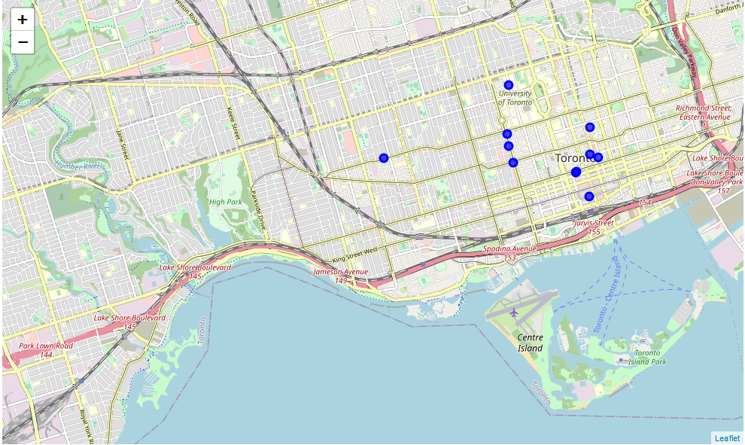
results
Map clustering results for hotel neighbourhood including shopping stores and Cafeteria

Slide 5
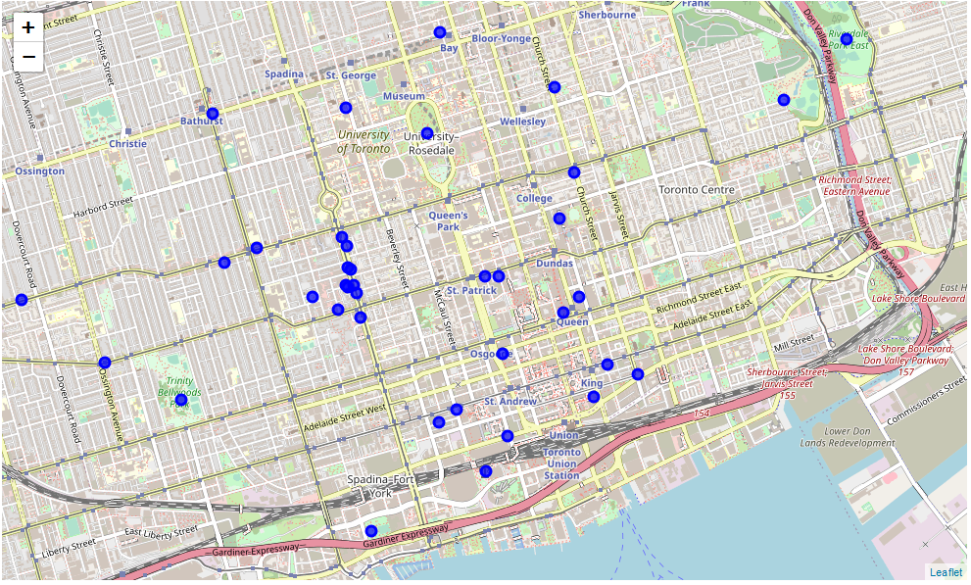
results
Map clustering results for hotel neighbourhood including parks, shopping stores and Cafeteria

